Slide 1
Analysis of COVID-19 Effects on the US Stock Market
Summer Project: June 2020
By:
Sunny Chavan
Cornell University, Class of 2023
NYC Area
Mentor and Supervisor:
Vandana Srivastava
ViSER LLC

Slide 2
Introduction
As the novel Coronavirus (COVID-19) has spread from China to all parts of the world, stocks have fallen drastically, and volatility has greatly increased
The extreme volatility and uncertainty, specifically in the United States, have given me the impetus to further explore these ideas within certain sectors of the market
I look to quantify, compare, and visualize the volatility of the top three companies, by market capitalization, in four major sectors of the market: Technology, Retail, Airline and Pharmaceutical

Slide 3
Companies Chosen for Study
Technology – Apple (AAPL), Amazon (AMZN), Google (GOOG)
Retail – Costco (COST), Walmart (WMT), Target (TGT)
Airline – Southwest (LUV), Delta (DAL), United (UAL)
Pharmaceutical - Johnson and Johnson (JNJ), Merck (MRK), Pfizer (PFE)

Slide 4
Methodology
Downloaded the adjusted closing stock price for each company listed above and the S&P500, between the dates of January 2nd and April 17th for 2019 and 2020 from Yahoo Finance
From the adjusted closing prices, calculated the daily percent change for each company and S&P500 in 2019 and 2020. Percent change is considered daily return
Calculated the standard deviation (SD) of the return in adjusted closing price for each stock in 2019 and 2020. This metric is used to measure volatility of a stock
Calculated the highest and lowest return for each stock in 2019 and 2020
Created a correlation matrix for all twelve companies in 2020 using the adjusted closing stock prices (not stock price return) as the correlative data

Slide 5
Technology Table Data and Observation
All three technology stocks had a much greater standard deviation of return in 2020 than that in 2019
The greatest uptick in SD is seen in Apple which climbed 3% from 2019 to 2020
The highest and lowest returns for all three stocks were to a much greater degree in 2020. For example, Apple had a maximum stock price change of about 12% in 2020 compared to 6.8% in 2019
Standard Deviation of the Return in Adjusted Closing Price and Highest and Lowest Return for the Technology Industry Companies in 2019 and 2020

Slide 6
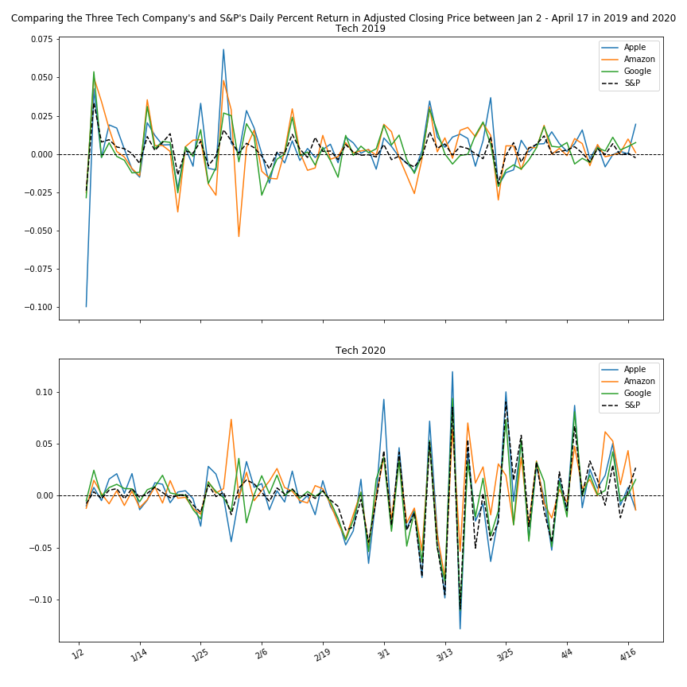
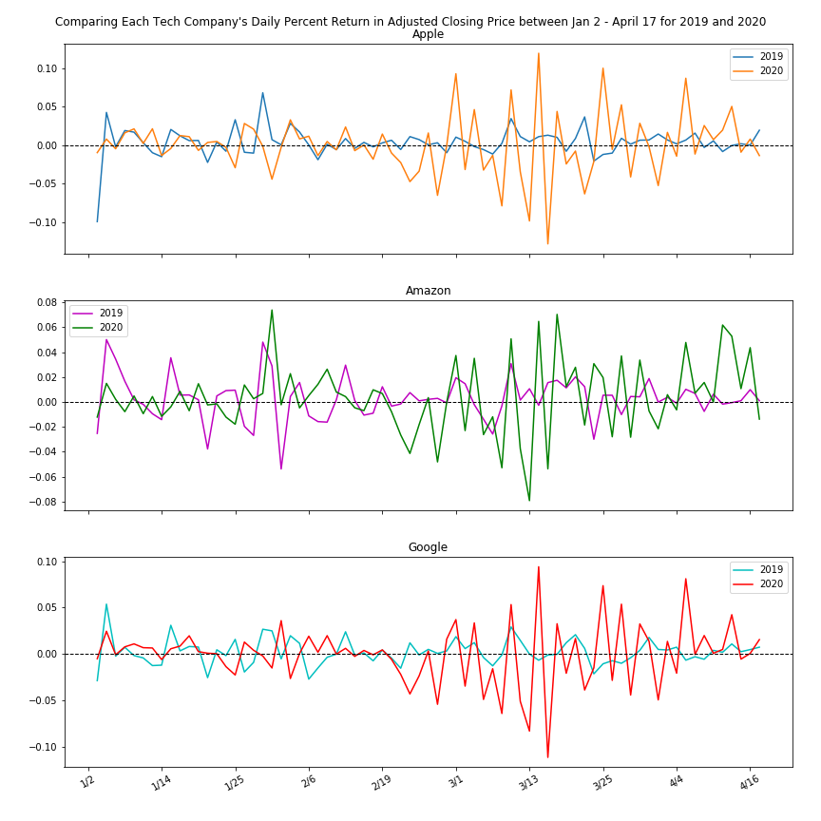
Technology Graph Data

Slide 7
Technology: Graph Observations
All three companies (Apple, Amazon, and Google) seemed to have much greater returns in 2020 compared to 2019 for the date range of January 2nd to April 17th
This disparity in return becomes increasingly prevalent after February 19th: Large jumps begin to show for all three companies starting around March 1st, 2020
It seems as if the return is to a slightly higher degree in 2019 than 2020 before February 19th. For example, Amazon in 2019 has more extreme jumps and dips than in 2020 in the first half of the date interval (before February 19th)
The S&P 500 seems to be completely in sync with the three technology companies in 2020 regarding returns. In 2019, the S&P 500 curve seems to be remotely connected with returns of the three stocks

Slide 8
Retail Table Data and Observations
Although the top three companies by market capitalization in Retail are Walmart, Costco, and Home Depot, Target was chosen instead of Home Depot: Home Depot mainly sells non-essential items that are not generally targeted during economic downturns
The standard deviation in return for each retail company in 2020 is about 2% greater than that in 2019
To exemplify this emerging chaos, one can look at Walmart which is usually a very stable and steady growth stock. In 2019, Walmart had a 0.8 SD. In the start of 2020, this metric jumped to 3
Walmart’s highest and lowest return in 2019 was 2.2% and -2.2% respectively. In 2020, this was 11.7% and -9% respectively
Standard Deviation of the Return in Adjusted Closing Price and Highest and Lowest Return for the Retail Industry Companies in 2019 and 2020

Slide 9
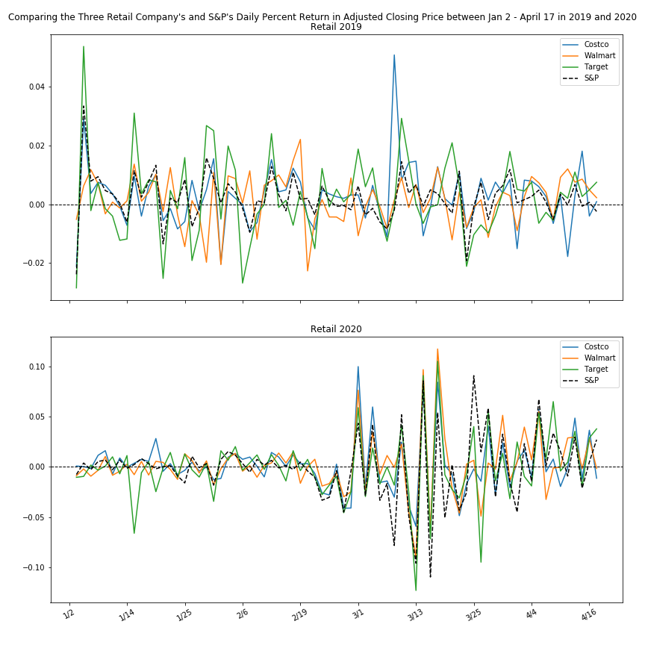
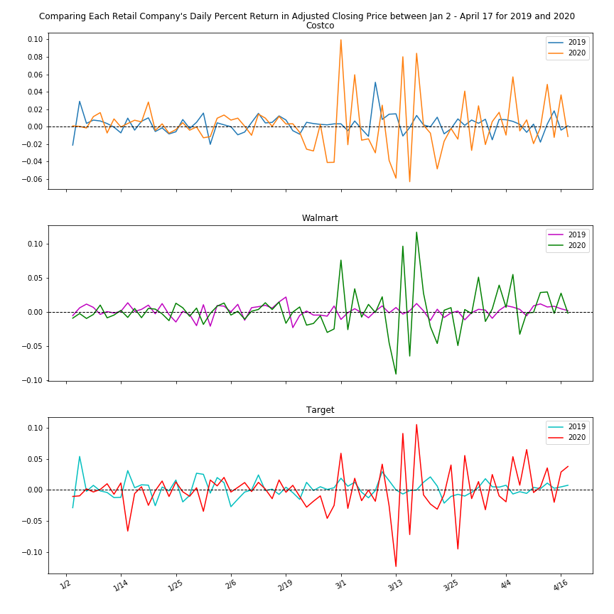
Retail Graph Data

Slide 10
Retail Graph Observations
All three companies had higher degree returns in 2020 compared to 2019 especially after February 19th
There is drastic difference in volatility between 2019 and 2020 for Retail. The maximum return reached for any retail company in 2019 was a bit greater than 4%, while in 2020, returns reached >8% multiple times
the S&P 500 does not seem to be correlated strongly with the retail industry in both years. In 2020 after February 19th, there are various instances where the S&P 500 had a much larger percent change than any of the three retail stocks
I believe the volatility of the retail industry is not directly correlated to COVID-19 and is rather following the pattern of the overall market. These retail companies can operate throughout the pandemic as they are considered essential businesses
Price volatility has occurred because investors are more focused on speculative investing and making small but quick returns within an already chaotic market

Slide 11
Airline Table Data and Observations
There is a major difference in return from 2019 to 2020 for all three US airline companies
The standard deviation of the return for Delta in 2019 for the given date interval was 6% and in 2020 the return was an astounding 25.7%. In addition, the highest return in 2020 for United was 25.7% and the lowest return was -30%
The disparity in volatility between Southwest, Delta and United for 2020 is rather interesting. For example, what is the reason that Southwest only reached a maximum return of 15% while Delta and United reached >20%?: This is something that can be explored in a separate study
Standard Deviation of the Return in Adjusted Closing Price and Highest and Lowest Return for the Airline Industry Companies in 2019 and 2020

Slide 12
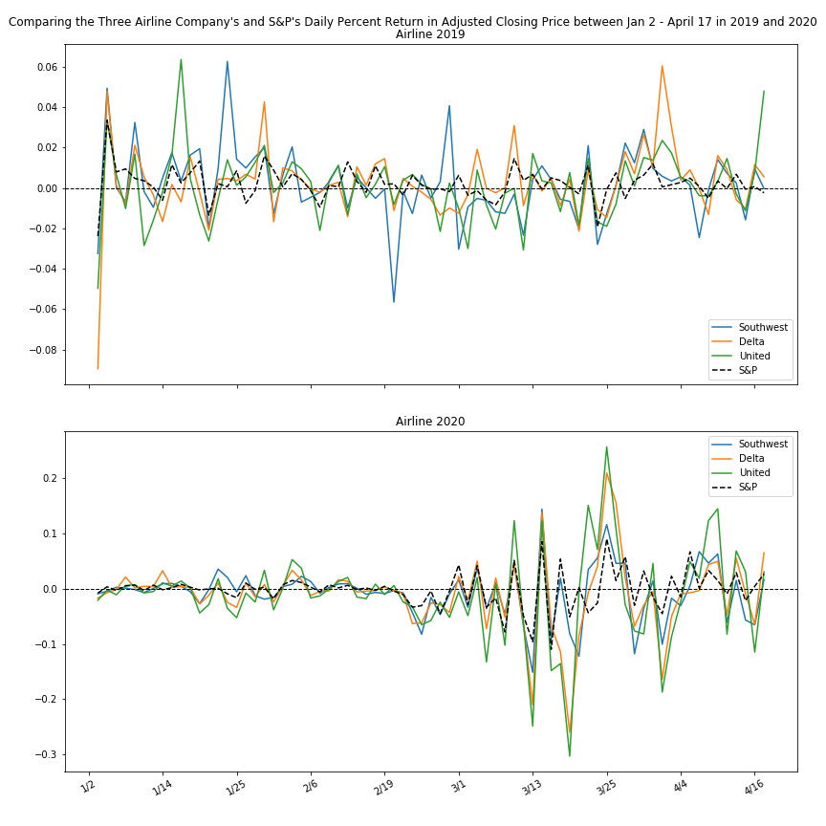
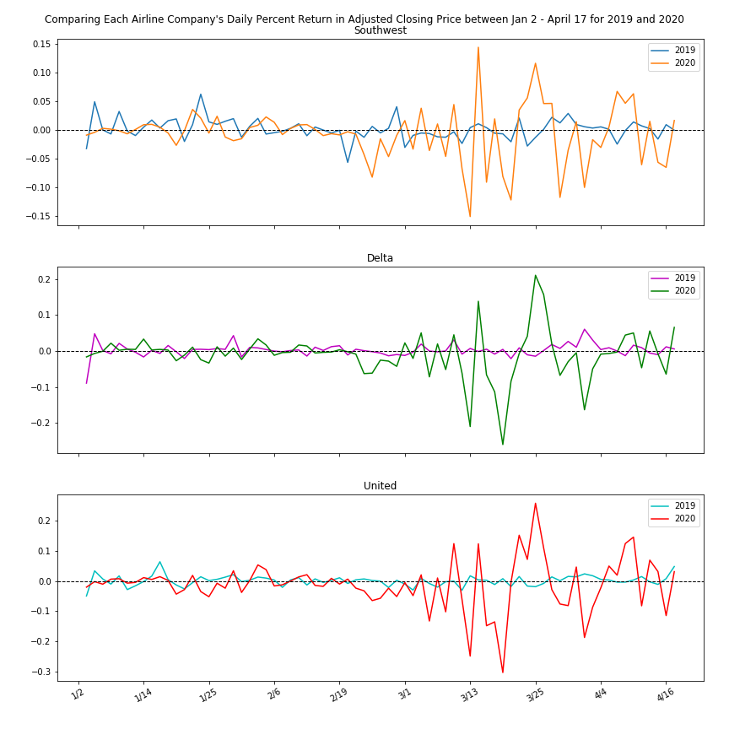
Airline Graph Data

Slide 13
Airline Graph Observations
All three airlines follow a common pattern following February 19th, 2020 (onset/realization of COVID-19 effects globally)
All three airlines have a daily return following February 19th in the negative. This means the stock prices were consistently declining
Then in between March 13th and March 25th, 2020, the return for each of the three companies goes positive as investors heard rumors of an airline stimulus package
Then the return is mostly negative until April 4th when the stimulus aid package is finally released
This flurry of events and various market signals greatly contributed to this volatility rise

Slide 14
Pharmaceutical Table Data and Observations
In 2019, the SD in return was about 2.5% to 3% for the three companies. In 2020, the SD in return was about 8% to 9%
each company has a highest return of about 8% to 9% and a lowest return of about -7.5% to -9% in 2020
These similarities suggest these companies are very much in sync, especially within the COVID-19 markets of 2020
Standard Deviation of the Return in Adjusted Closing Price and Highest and Lowest Return for the Pharmaceutical Industry Companies in 2019 and 2020

Slide 15
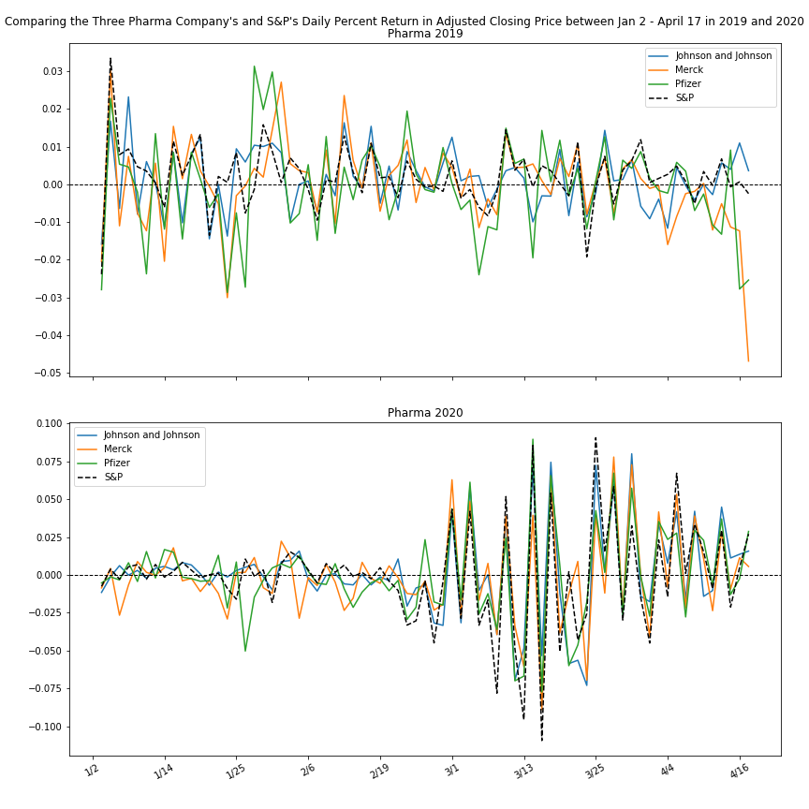
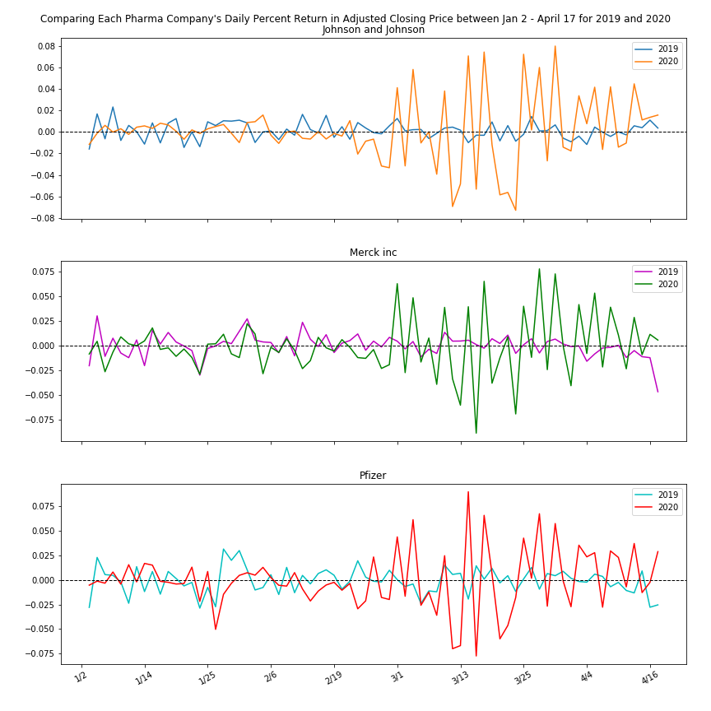
Pharmaceutical Graph Data

Slide 16
Pharmaceutical Graph Observations
Similar to the other 3 industries, the three companies in the Pharmaceutical Industry were very volatile in the second half (after February 19th) of the 2020 time interval
The return in 2019 before February 19th, seems to be as volatile as the return in 2020 before February 19th
In 2019, the S&P 500 (SPY) seems to differ greatly with the three other companies. This is also the case for the first half of the 2020 time interval, before February 19th
After February 19th in 2020, the SPY returns seem to strongly correlate with the returns of Johnson and Johnson, Merck and Pfizer

Slide 17
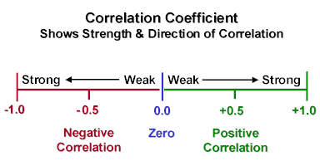
Inter-Industry Correlation Matrix Data
The table below (Figure 17) is a correlation matrix in which the stocks are considered the variables and the data used to find correlations is the adjusted closing price of each stock between January 2nd and April 17th in 2020 (2019 was excluded for this analysis)
Correlation Matrix
Correlation Matrix Legend

Slide 18
Correlation Matrix Observations
Technology
Apple and Google were perfectly correlated with each other. This was expected as these two technology giants compete for the same consumers and create technologies that overlap in the market (phones, tablets, headphones, etc.)
Amazon had a very weak positive correlation with its technology counterparts (Apple and Google). This may seem illogical at first, but one needs to realize that Amazon is a retail organization as much as it is a technology giant
Retail
None of the retail companies have strong or perfect positive correlations: They are all weak positive correlations
Walmart and Target, two low-cost retail stores with gigantic revenues, are barely correlated with a coefficient of .1459. This case is interesting as these two businesses are direct competitors with one another

Slide 19
Correlation Matrix Observations Continued
Airline
All three airlines had perfect positive correlations with each other. This was expected as the airline industry was extremely volatile
Pharmaceutical
All three Pharmaceutical companies had either perfect or extremely strong (>0.8) positive correlation coefficients
Inter-Industry
Apple and Google have a strong positive and perfect positive correlation respectively with the three companies in the airline industry
Both Walmart (retail) and Amazon (technology) have negative correlations with the airline industry
The three companies in the airline industry all have a strong positive correlation with the three companies in the Pharmaceutical industry

Slide 20
Conclusion
This combination of volatility and correlation matrix comparisons was an effective way of analyzing how COVID-19 impacted these industries
To add to this study, one can use co-variance in stock return as a second measure of volatility. Also, one could expand the scope of this research to analyzing more industries
An idea for another study can be splitting up the 2020 time interval into 2 different periods: January 2nd to February 19th and February 20th to April 17th. This would be extremely interesting as a common theme in this report was that many stocks had increasing volatility after February 19th
The model and methods used in this study are flexible: Thus, they can be used in the future to analyze economic recessions, booms, pandemics, and other market swaying events

